Slide 1


GNA HACKATHON 3.0
Theme: AR/VR
Topic Name: AR-Based Personalized Learning Platform for kids
Category: Software
Team ID: DST-156
Team Name: The Rookies

Slide 2
Proposed Solution
GNA HACKATHON 3.0
Traditional Learning methods can be unengaging for kids, so our app uses AR and AI to make learning more interactive and fun!
Kids' attention spans are shrinking. Studies show that children today struggle to focus for more than 33 minutes at a time.
Traditional learning methods can lead to boredom and poor retention.
Students struggle to visualize concepts with textbooks alone, making learning difficult.

Slide 3

Our Solution
GNA HACKATHON 3.0
EduQuest
Where Imagination Meets Education!

Slide 4
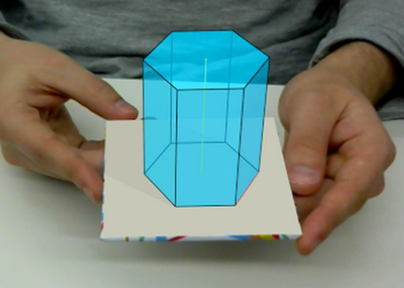
How does it work?
GNA HACKATHON 3.0
Learn by Doing with AR: Kids can visualize math concepts, and understand science through interactive AR models, making learning fun and hands-on.
Adaptive Learning: EduQuest uses AI to adjust lessons and quizzes to match each child’s learning pace and provide a gamified learning experience.
Streak System: Keeps kids motivated with daily learning streaks and smart reminders to stay consistent.
Gamification & Leaderboards: Rewards progress with points, badges, and leaderboards to encourage healthy competition.
Visualizing Math concepts using AR

Slide 5
Impacts & Benefits
GNA HACKATHON 3.0
Gamified learning can improve student performance by up to 89.45% compared to traditional methods.¹
76% of students report that technology makes learning more engaging.²
Affordable, multi-device access ensures that kids from all backgrounds can learn efficiently with fewer barriers.
Teachers in primary schools have access to only about 46% of the materials required to teach practical science effectively.³
¹ Attotime
² EdWeek, “Technology in Schools: A Teacher Survey”, 2023
³ Royal Society of Chemistry

Slide 6



Technical Implementation
GNA HACKATHON 3.0
EduQuest will be built using:
Flutter for the mobile app enabling cross-platform support.
Unity3D for AR implementation & interactive learning.
Firebase for authentication, storing progress, and providing analytics.
Interactive lessons will be developed in the Unity game engine and integrated into Flutter. An OpenAI API will analyze student interactions to create personalized lesson.

Slide 7
Market Opportunity
GNA HACKATHON 3.0
Growth in Demand
EdTech market → $404B by 2025 (16.3% CAGR). (HolonIQ)
AR in education → $7B by 2027. (MarketsandMarkets)
Rising Adoption of Homeschooling & Online Learning
75% of parents prefer digital tools. (Common Sense Media)
Homeschooling up 56% in a decade. (NHERI)

Slide 8
Feasibility & Viability
GNA HACKATHON 3.0
Tech Readiness
Built with Flutter & Unity3D, ensuring cross-platform compatibility.
AI & AR tools are mature and widely adopted in EdTech.
Scalability & Monetization
Freemium model with premium features (AI insights, advanced AR)
Partnerships with schools & EdTech platforms for B2B growth.
Implementation Ease
Uses existing AI & AR frameworks, reducing development time.
Cloud-based backend (Firebase) ensures seamless updates and scalability.

Slide 9
Let’s see it in action!
GNA HACKATHON 3.0
Presented By:
S.No. | Name | Class | GU-ID | Email | Phone
1 | Manbir Singh | B.Sc. DMSN II | GU-2024-1222 | 0.manbirsingh@ gmail.com | 8544927261
2 | Anish | BCA II | GU-2024-1417 | anish905699@ gmail.com | 9878849923
3 | Krishna Kanda | BCA II | GU-2024-1492 | krishnakanda33@ gmail.com | 7837917080

